Slide 1
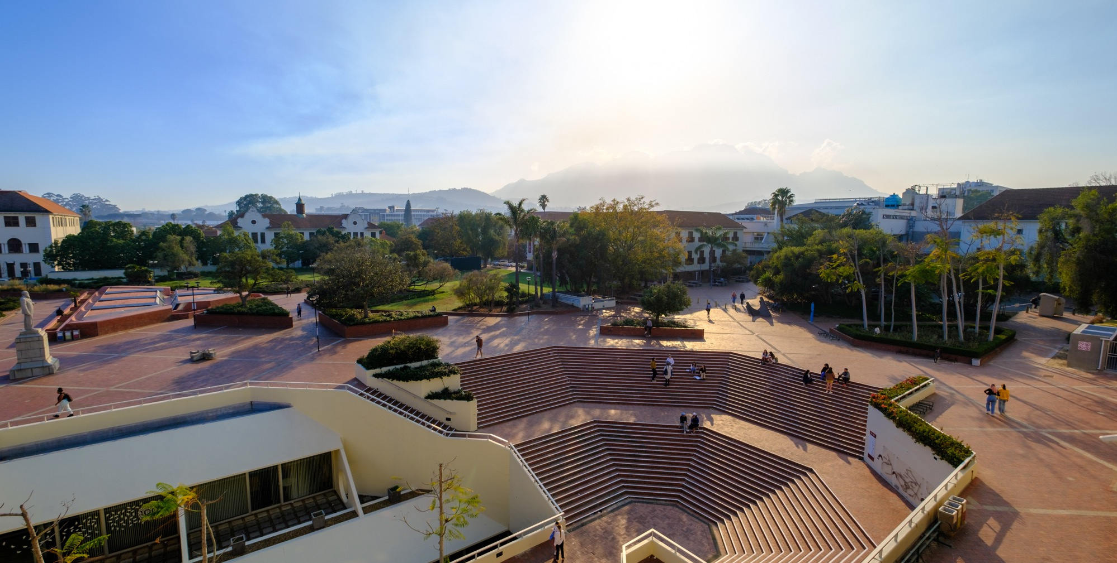


A Stakeholder-Informed Framework for the
Development of a SASL Sign Bank
Towards Linguistic Equity, Accessibility, and National Infrastructure
Candice Morgan — Stellenbosch University
29 May 2026
Photo by Stefan Els
Notes:
Picture placeholder slide layout
To change the picture:
Select the picture by clicking on it near the bottom of the slide (under the title placeholder), then click on the Picture Format tab.
Click on the Change Picture icon and choose the From a File/This Device… option.
Browse and select a picture and click on the Insert button.
Use the Crop command to adjust the image.
Click on the Crop command again to apply the changes.
Remember to add image attributions to photographs or artworks.
2

Slide 2

Purpose of the Presentation
Objectives
• Present findings from stakeholder consultations
• Define conceptual and operational framework for SASL
sign bank
• Highlight considerations:
governance
technology
educational
linguistic

Slide 3
Purpose of the Presentation
Stakeholder Consultations
24 interviews conducted with:
• Deaf community members
• Parents of Deaf/hearing children
• Deaf organisations
• Institutional representatives
• Sign linguists
• Educators
• Technologists
• Interpreters

Slide 4
Why a SASL Sign Bank Matters
Current Challenges
  Fragmented SASL resources
  Unequal regional access
  Limited curriculum-aligned content
  Accessibility barriers in education and service sectors

Slide 5
Strategic Importance
The SASL Sign Bank Supports:
Key Message:
  Language equity
  Educational inclusion
  Communication access
  Technological innovation
The sign Bank is not merely a dictionary —
it is national linguistic
and research infrastructure.
  Language development
  Promotion of an official SA
  language

Slide 6
Conceptual Foundation
Beyond a Dictionary
  The Sign Bank should function as:
  A dynamic, evolving system
  A communication resource
  A research infrastructure
  An educational support platform
  A technological data ecosystem

Slide 7
Core Principle
Centralisation without Homogenisation
  The sign bank should:
  Preserve linguistic diversity
  Document regional variation
  Support practical consistency where needed – which sign is best used in which domain?

Slide 8
A Dual-Layer Model
Layer 1: Descriptive Documentation
  Records variation across:
  Regions
  Generations
  Contexts
  Preserves authentic language use

Slide 9
A Dual-Layer Model
Layer 2: Recommended Usage
Balance Required
  Linguistic authenticity
  Functional usability
Supports:
  Schooling
  Assessment
  Professional communication
  Institutional contexts

Slide 10
Deaf-Centred Governance
Deaf individuals must be:
  Authors
  Validators
  Decision-makers
  Custodians
This is a
non-negotiable, central principle

Slide 11
Deaf-Centred Governance
Governance Requirements
  Inclusive representation
  Co-creation models
  Community validation processes
  Long-term accountability
Ethical Imperatives
  Informed consent
  Transparency
  Intellectual property protection
  Community ownership

Slide 12
Multi-Layered Content Architecture
The Sign Bank Must Support –
Everyday Communication
  Family interaction
  Basic vocabulary
  Home communication
Early Childhood Development
  Child-centred signing resources
  Language acquisition support

Slide 13
Multi-Layered Content Architecture
The Sign Bank Must Support –
Education
  Curriculum-aligned terminology
  Science, Technology, Education, Mathematics vocabulary
  Teacher support

Slide 14
Professional & Research Domains
The Sign Bank Must Support –
Professional Domains
• Healthcare
• Legal systems
• Workplace communication
• Public services
Research & Linguistics
• Metadata
• Grammar
• Semantic relationships

Slide 15
Educational Impact
Current Gap:
Limited signed academic content in:
• Mathematics
• Science
• Technology
• Professional disciplines

Slide 16
Educational Impact
Proposed Contribution: The Sign Bank can:
• Improve classroom accessibility
• Support Deaf learners
• Assist educators and interpreters
• Enable bilingual learning environments
Higher Education Uses
• SASL courses
• Interpreter training
• Linguistic research
• Academic terminology development

Slide 17
From Words to Meaningful Communication
Problem with Existing Resources
Many focus only on isolated vocabulary.
SASL Requires Context
Meaning depends on:
• Facial expression
• Movement
• Context
• Non-manual features

Slide 18
Communication-Oriented System
Key Shift
The Sign Bank Should Include
From static lexicon → communication-oriented system
• Signs
• Usage examples
• Real-life scenarios
• Semantic explanations
• Connected discourse

Slide 19
Technological Design Principles
Core Requirements
Video-First Design
• High-quality recordings
Accurate representation of:
• Handshape
• Movement
• Orientation
• Facial expression

Slide 20
Multimodal Interface
Core Requirements
• Text
• Images
• Optional audio
• Visual navigation
User Experience Priorities
• Simplicity
• Accessibility
• Intuitive navigation

Slide 21
Advanced Platform Functionality
Search Features
Community Participation
• Word-to-sign lookup
• Sign-to-meaning search
• Visual parameter search
• Related sign navigation
• User-generated contributions
• Validation workflows
• Continuous updating
Learning Tools
• Practice activities
• Feedback systems
• Thematic browsing

Slide 22
Accessibility & Low-Resource Design
Essential Requirements
Design Principle:
Accessibility must be foundational, not optional.
• Mobile compatibility
• Low data usage
• Offline functionality
• Zero-rated access where possible
• Compatibility with basic smartphones
Why It Matters
Without inclusive technological design:
• Existing inequalities may deepen
• Rural and low-income users may be excluded

Slide 23
Integration with Broader Ecosystems
The Sign Bank Should Connect To
• SASL corpora
• Grammar resources / GramBank
• Annotation tools
• Educational technologies
• AI and machine learning systems

Slide 24
Integration with Broader Ecosystems
Key Insight:
The Sign Bank is both a language resource and a data infrastructure.
Long-Term Potential
Supports:
• Automatic sign recognition
• Machine translation
• Digital learning tools
• Linguistic analytics

Slide 25
Dissemination & Adoption Strategy
Dissemination Must Be Ongoing
Not a once-off launch
Institutional
• Schools for the Deaf
• Universities
• Training programmes
Community-Based
• Workshops
• Demonstrations
• Deaf networks

Slide 26
Dissemination & Adoption Strategy
Dissemination Must Be Ongoing
Not a once-off launch
Digital
• Social media
• Deaf influencers
• Online campaigns
Sustainability Depends On:
• Continuous updating
• User feedback
• Institutional support

Slide 27
Structural Challenges
Current Problems
What Is Needed: Partnerships involving:
• Fragmented initiatives
• Duplication of effort
• Limited collaboration
• Resource competition
• Deaf organisations
• Government
• Researchers
• Universities
• Technology partners

Slide 28
Structural Challenges
Key Requirements:
• Significant Deaf contributions and leadership
• Long-term partnerships
• Institutional coordination and support

Slide 29
Strategic Outcomes
If Successfully Implemented, the Sign Bank can:
• Improve early language acquisition
• Strengthen family communication
• Enhance educational access
• Increase workplace inclusion
• Advance SASL research
• Support technological innovation
• Strengthen SASL as an official language

Slide 30
Strategic Outcomes
The sign bank is a critical step toward linguistic equity
and social inclusion in South Africa, while opening
avenues for scientific research and technological
innovation

Slide 31
Conclusion
The SASL Sign Bank Is:
• Linguistic infrastructure
• Educational infrastructure
• Technological infrastructure
• Social inclusion infrastructure

Slide 32
Conclusion
Success Depends On
• Deaf-centred governance
• Inclusive design
• Sustainable partnerships
• Institutional commitment

Slide 33
Conclusion
The Sign Bank has the potential to transform
access to language, education, information,
and opportunity for Deaf communities in
South Africa

Slide 34
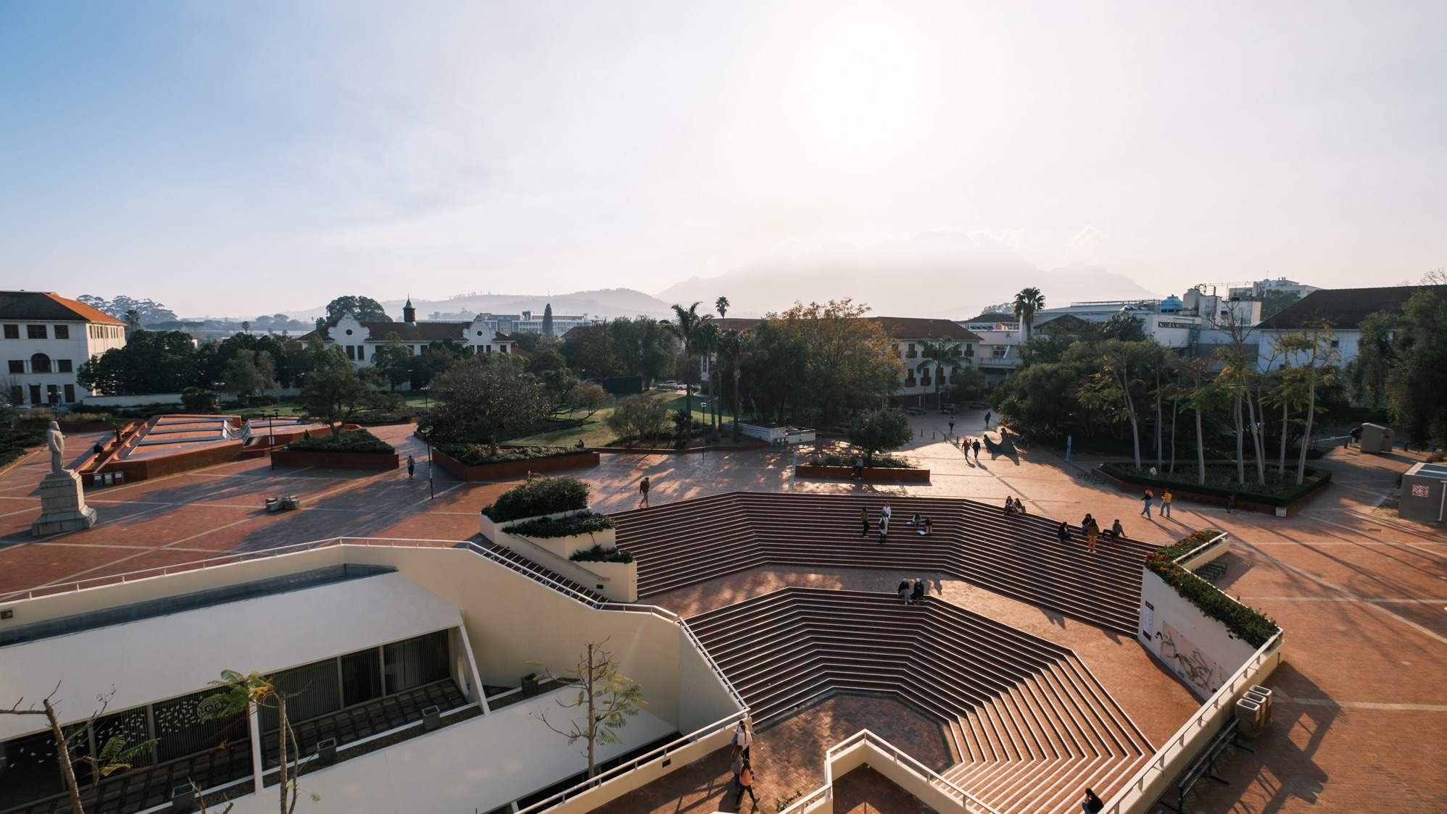

Thank you
Enkosi
Dankie
Photo by Stefan Els
Division. Centre. Unit Name
Notes:
Cover/End slide layout
To change the picture:
Select the picture by clicking on it near the bottom of the slide (under the title placeholder), then click on the Picture Format tab.
Click on the Change Picture icon and choose the From a File/This Device… option.
Browse and select a picture and click on the Insert button.
Use the Crop command to adjust the image.
Click on the Crop command again to apply the changes.
Remember to add image attributions to photographs or artworks.
19

