Slide 1
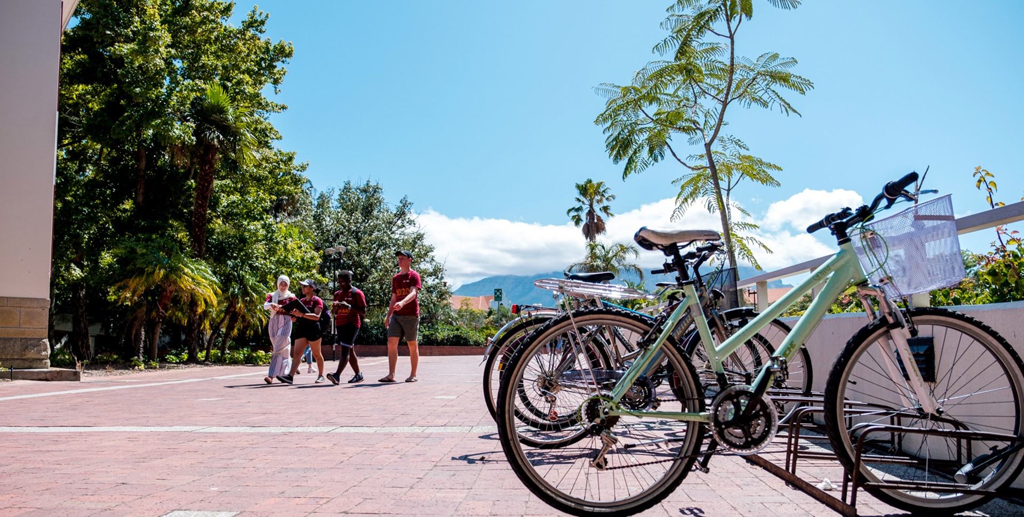

South African Sign Language
(SASL) Resources)
Private Sector and
Higher Education Initiatives
Photo by Stefan Els
Notes:
Picture placeholder slide layout
To change the picture:
Select the picture by clicking on it near the bottom of the slide (under the title placeholder), then click on the Picture Format tab.
Click on the Change Picture icon and choose the From a File/This Device… option.
Browse and select a picture and click on the Insert button.
Use the Crop command to adjust the image.
Click on the Crop command again to apply the changes.
Remember to add image attributions to photographs or artworks.

Slide 2
[Apologies for any omissions or inaccuracies]
This is a point of departure …
Photo by Stefan Els
Notes:
Picture placeholder slide layout
To change the picture:
Select the picture by clicking on it near the bottom of the slide (under the title placeholder), then click on the Picture Format tab.
Click on the Change Picture icon and choose the From a File/This Device… option.
Browse and select a picture and click on the Insert button.
Use the Crop command to adjust the image.
Click on the Crop command again to apply the changes.
Remember to add image attributions to photographs or artworks.

Slide 3
Private Sector Resources [1]
• Accessibility with Jabaar: Recordings of talk show confronting misconceptions about disabilities
• Andiswa Gebashe – AND I SIGN: YouTube creator using SASL in educational content
• BookDash: Children's books in SASL
• DeafNET: Network connecting Deaf and hearing communities
• Deaf Federation of South Africa (DeafSA): Videos on social media

Slide 4
Private Sector Resources [2]
• Deaf Touch: Platform supporting communication and accessibility
• DTV | DeafTV South Africa: Deaf TV programme with online videos
• eDeaf: Videos aimed at the Deaf for skills development training in SASL
• Handlab: Stories, debates, poems, dramas and other genres in SASL

Slide 5
Private Sector Resources [3]
• Jimmy Swafo South African Sign Language SASL: Youtuber with some SASL videos, mostly shorts
• Khomotso_Maluleke-Skhosana: SASL for beginners videos
• Knowtice: Youtuber that has a playlist of SASL videos
• Learn SA Sign Language: Photos of how to sign specific words
• Lekker Deaf SA: Community Facebook group
• Lindokuhle Glenrose: 7 videos on YouTube signing songs in SASL

Slide 6
Private Sector Resources [4]
• National Institute for the Deaf (NID): DIY videos, information videos, SASL worship songs, storybooks, digital interactive educational books, Deaf awareness material, SASL posters, dictionary, online course, online learner license course
• Real SASL: Dictionary with searchable sign categories
• REAH: Developing wearable SASL interpretation technology
• South African National Deaf Association (SANDA): Human rights and advocacy organisation of Deaf people

Slide 7
Private Sector Resources [5]
• SASL DEAFinition: Free app with searchable SASL vocabulary
• SASL - Skills Training: YouTube content creator teaching SASL (44 videos)
• Signing with Mel SASL: Hearing teacher of the Deaf, teaching the hearing basic signs and guiding young Deaf children with some educational, physical and story telling during the COVID-19 lockdown (47 videos)
• SLED: Learning and teaching resources in SASL

Slide 8
Private Sector Resources [6]
• SociGO: Promotes Deaf culture through arts and sport
• The Sign Tutors: Lessons and vocabulary videos on YouTube
• Talk Sign: SASL phrases in picture
• Tom Deaf Guy: Content creator on YouTube who is Deaf and uses SASL in his videos
• Twinkl: Teacher resources including posters and flashcards
• Unmute With Hands: 4 instructional videos on YouTube

Slide 9
Private Sector Resources [7]
• Vocal Hands: YouTube channel for interaction between Deaf and hearing community; to learn more about Deaf community (7 videos)
• Vodacom Emergency Services: Emergency support services for Deaf individuals
• wieisek?: Website on mental health; some information translated to SASL with videos
• Yellow Owl: SASL Interpreted Content: Interpreted media content in SASL

Slide 10
Higher Education Resources [1]
• Durban University of Technology: SASL translations for emergency communications
• North-West University: Courses in SASL
• Rhodes University: Dictionary resource mentioned in talks
• Sol Plaatje University: Courses in SASL
• Stellenbosch University: Courses in SASL, SASL corpus creation, SASL teaching material

Slide 11
Higher Education Resources [2]
• University of Cape Town: Website translated into SASL and SASL teaching initiatives
• University of South Africa: Research collaboration with Deaf community members
• University of the Free State: SASL toponymic corpus projects
• University of Johannesburg: Wearable glove technology converting SASL to text/speech
• University of Limpopo: SASL office and plans for a term bank

Slide 12
Higher Education Resources [3]
• University of Pretoria: Industry-focused SASL training programme
• University of the Western Cape: Digital SASL phrasebook and SignSupport apps
• University of the Witwatersrand: BA and postgraduate SASL studies
• Walter Sisulu University: Digital avatar innovation for SASL communication

Slide 13
Observations
• Growing availability of digital SASL resources across sectors
• Contributions by Deaf-led organisations and Deaf individuals
• Strong emphasis on accessibility, education, and advocacy
• Role of universities in corpus creation and technology development
• Partnership opportunities exist between academia, NGOs, and private initiatives

Slide 14
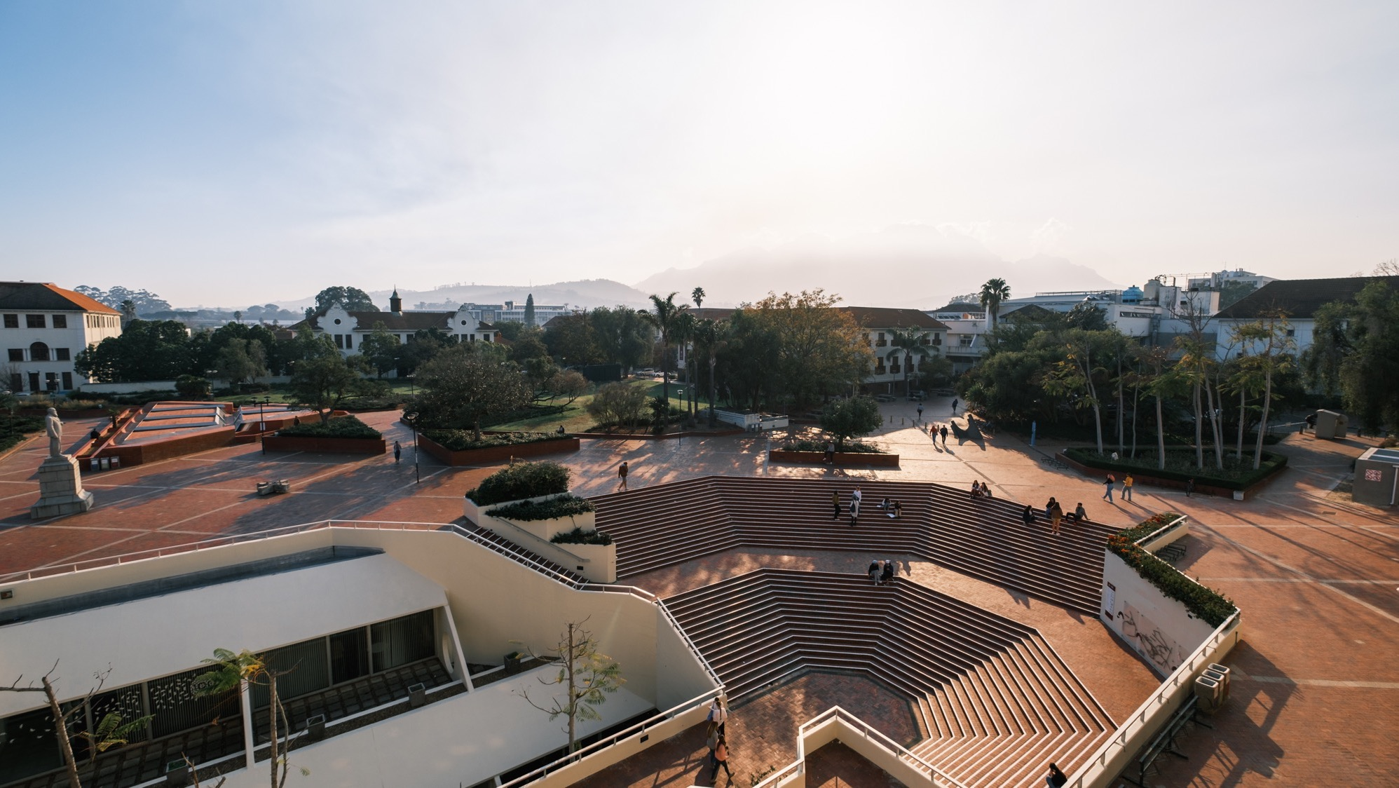
Thank you
Enkosi
Dankie
Questions
• What existing resources are not yet in the inventory?
• How can the inventory be kept current?
• What kind of curatorship is required?
Photo by Stefan Els
Notes:
Cover/End slide layout
To change the picture:
Select the picture by clicking on it near the bottom of the slide (under the title placeholder), then click on the Picture Format tab.
Click on the Change Picture icon and choose the From a File/This Device… option.
Browse and select a picture and click on the Insert button.
Use the Crop command to adjust the image.
Click on the Crop command again to apply the changes.
Remember to add image attributions to photographs or artworks.

