Slide 1
Developing a wordnet for South African Sign Language: Proof of concept
Marissa Griesel
Marissa.griesel@nwu.ac.za
29 May 2026, Pretoria
License: CC BY 4.0

Slide 2
What is a wordnet?
Not ‘just’ an online dictionary
“WordNet is a semantic dictionary that was designed as a network, partly because representing words and concepts as an interrelated system seems to be consistent with evidence for the way speakers organize their mental lexicons.” (Fellbaum,1998:7)
Large electronic lexical database
  Hierarchically and semantically organised description of lexemes of a language in electronic format - synonyms are grouped into synsets and linked by conceptual-semantic and lexical relations
    Hypernyms, hyponyms, meronyms & holonymy are most prevalent relations
  Includes definitions and usage examples for each synet

Slide 3
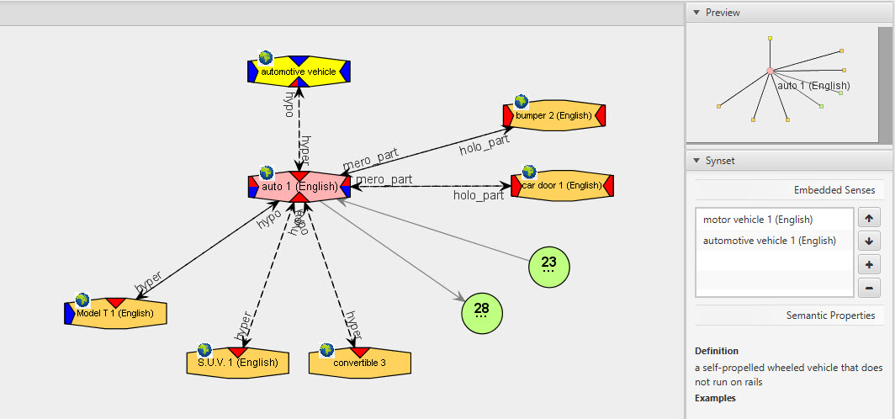
What is a wordnet?
Notes:
Semantic relations organise the synsets

Slide 4
Princeton WordNet (PWN)
Princeton WordNet (PWN) is freely and publicly available
  http://wordnet.princeton.edu/
PWN consists of four sub-nets, one each for nouns, verbs, adjectives and adverbs
  117 659 synsets for English
Since the 1990s, Wordnets have been built in other languages, incl. many that are genetically and typologically unrelated to original PWN
All wordnets listed as GWA members have to link to PWN either directly or as a post-processing step

Slide 5
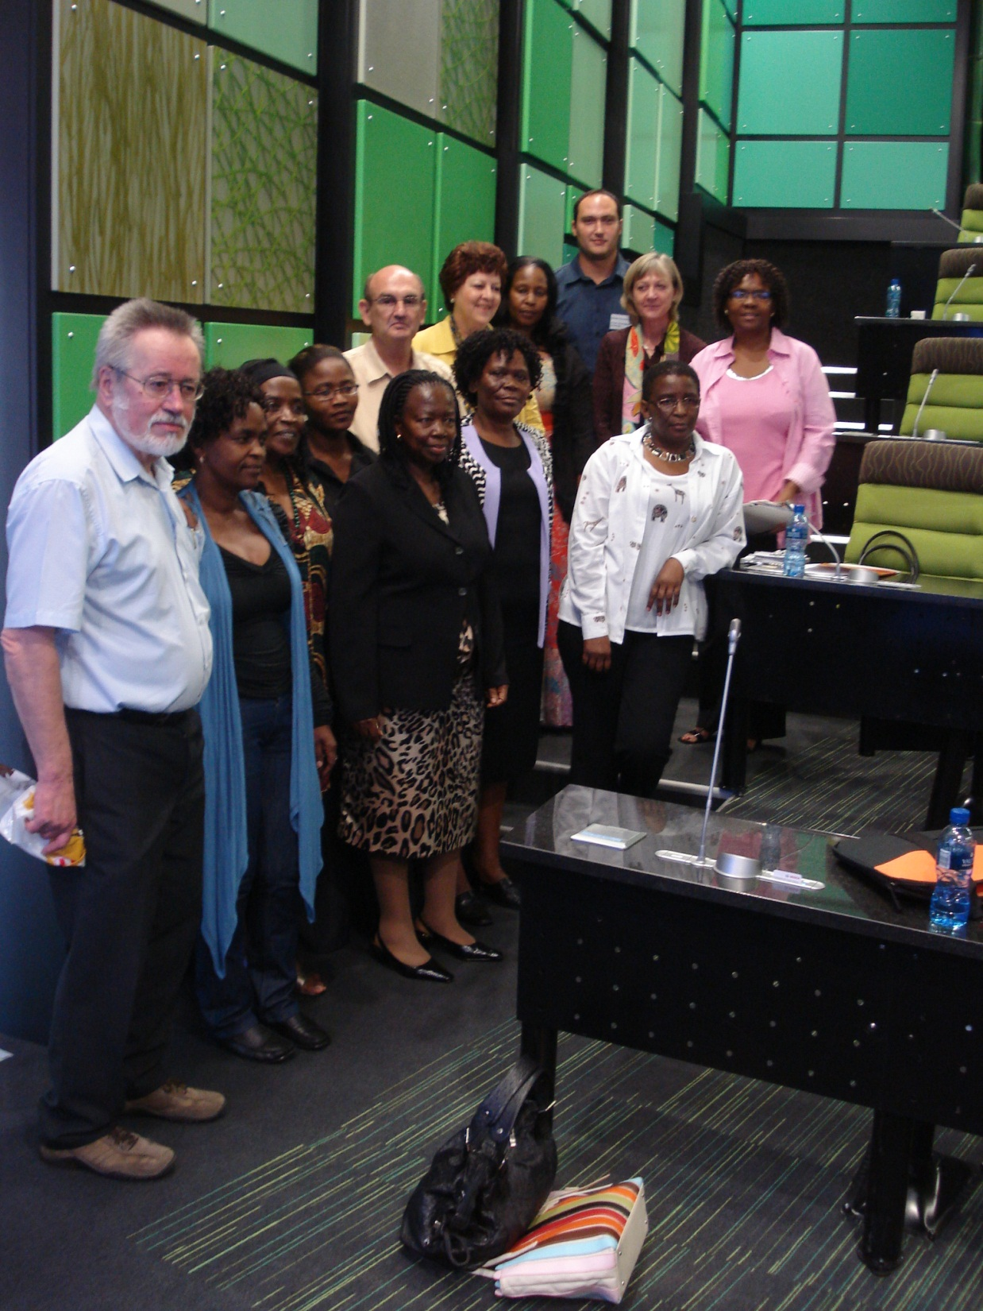
The African Wordnet Project
Following the “expand model”, meaning we used the PWN as template and systematically developed our own content
The AfWN project includes just over 80 000 synsets
  Development of wordnets for South African languages started with a small team in 2010 and has grown to include all 9 indigenous languages
  We started with a workshop hosted by international experts from the PWN team
  Currently we have a team of about 40 linguists
  Research into best practice for development,
  linguistic aspects that need consideration and
  application of wordnets to other HLT solutions is key
  See https://africanwordnet.wordpress.com/

Slide 6
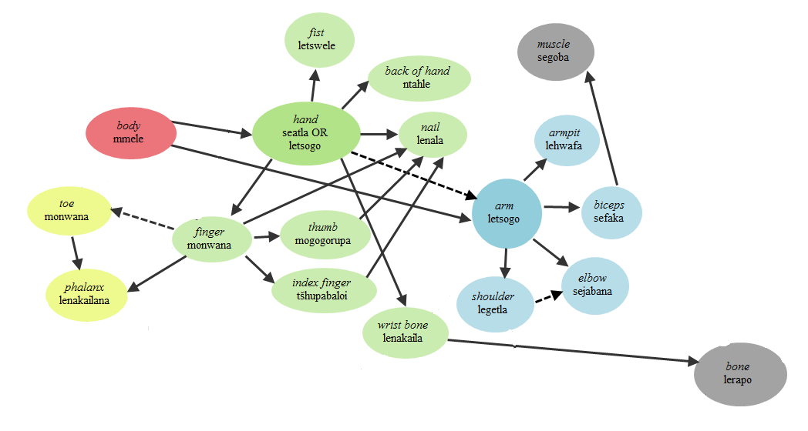
Notes:
Semantic relations organise the synsets

Slide 7
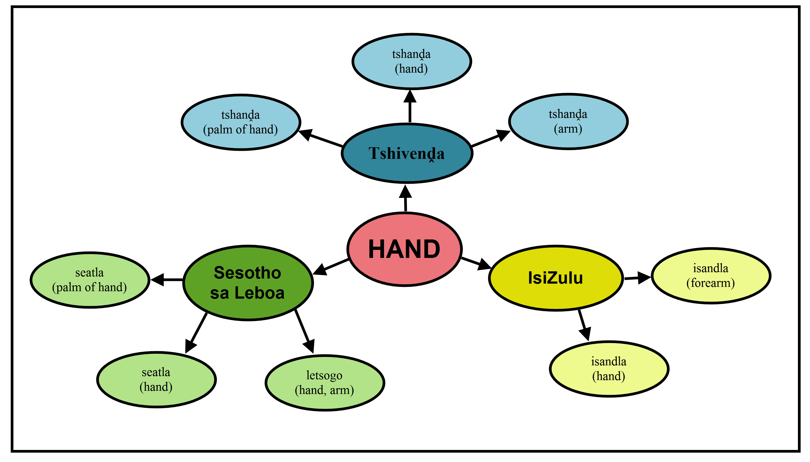

Slide 8
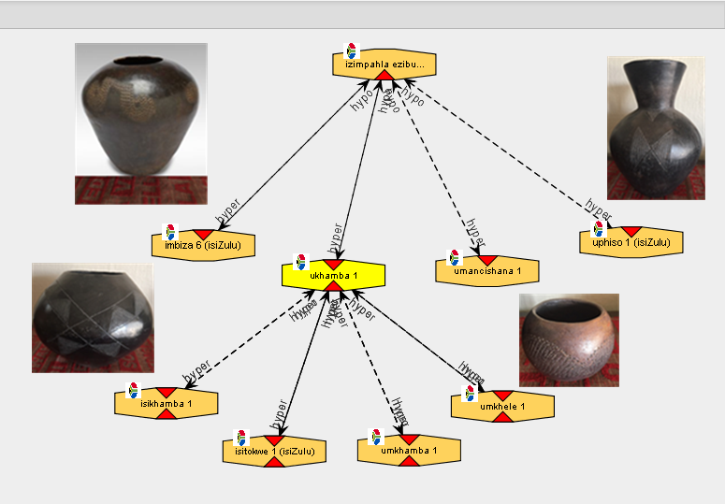
Photos of the beer vessels by Prof Sonja Bosch. See https://lexikos.journals.ac.za/pub/article/view/1603

Slide 9
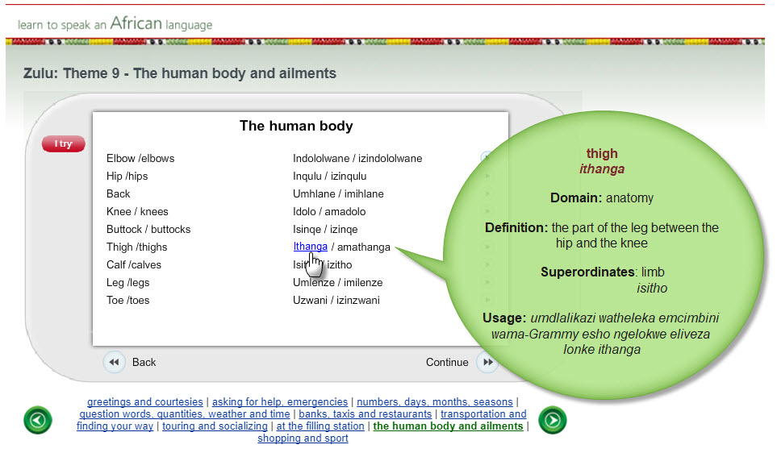
See http://compling.hss.ntu.edu.sg/events/2018-gwc/pdfs/gwc-2018-proceedings.pdf

Slide 10
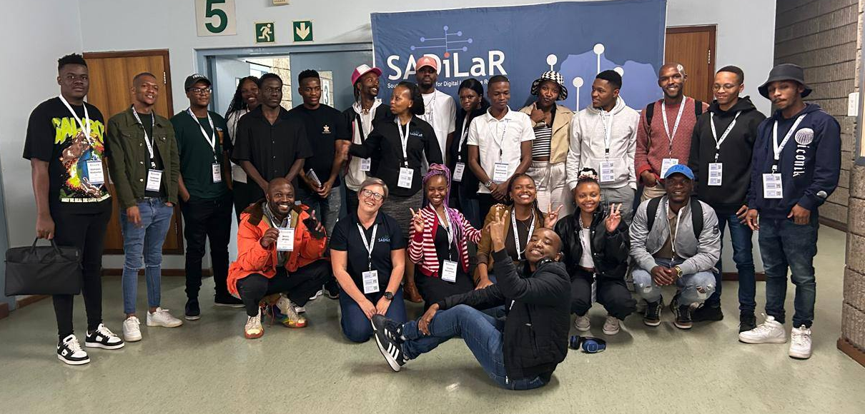


Capacity development workshops
The Unisa node is currently taking the AfWN to students across South Africa in a series of workshops, supported by the ESCALATOR flagship programme
The aim is to provide students and staff at language departments with skills to participate in language resource development projects such as these

Slide 11
Adding SASL to the AfWN project
As with the other languages, we have a template to use, at least while we are finding our feet
The Open Multilingual Signed Wordnet
  Includes German Sign Language, Greek Sign Language, British Sign Language, Sign Language of the Netherlands, French Sign Language, Swiss German Sign Language, Swedish Sign Language and Polish Sign Language
  It contains 24,367 links between 14,028 signs and 16,534 (universal) synsets
  It is a work in progress and the coverage for individual languages is still limited
  See https://www.sign-lang.uni-hamburg.de/easier/sign-wordnet/
Initial discussions with the development team at University of Hamburg were very positive
  Their “template” was made available to us for expansion to SASL
  The team under Dr Marc Schulder also offered assistance with training, extracting synsets from existing material and research

Slide 12
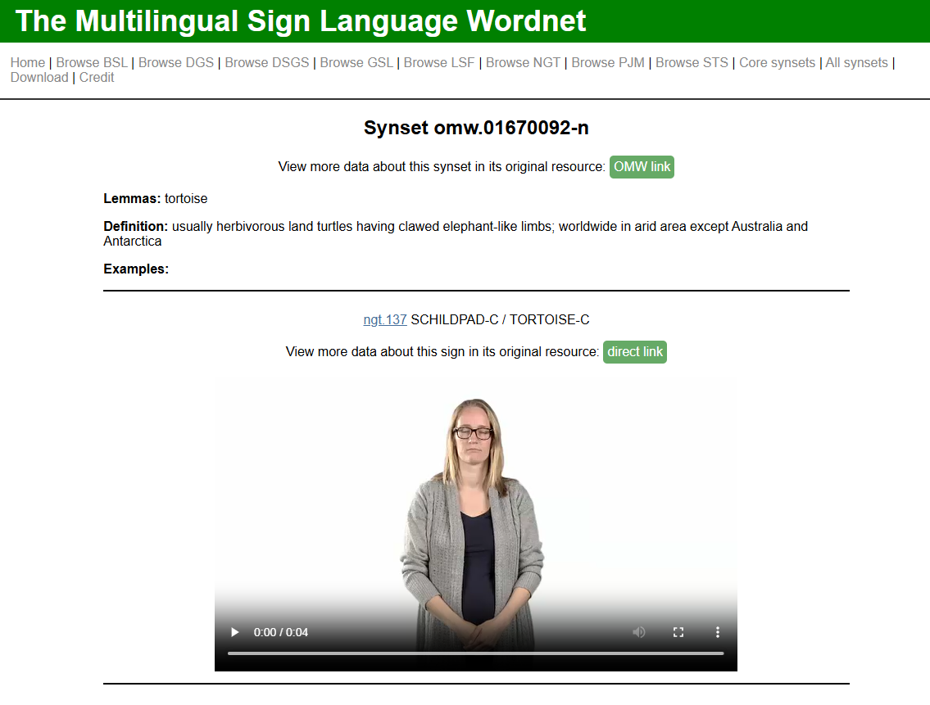
tortoises can grow very old and have unique shell patterns

Slide 13
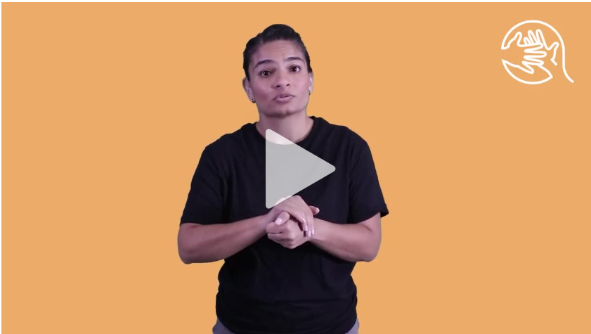
Lemma: tortoise
Domain: animals
Link: omw.01670092-n
Definition: purely land-dwelling chelonians with a hard shell and four limbs
Examples: a tortoise carries its home on its back
Synonyms:
Hypernyms: reptile
Hyponyms: leopard tortoise
…

Slide 14

Adding SASL to the AfWN project
We have an opportunity to design and populate this resource for SASL
Collaborators are needed to do this
SADiLaR can assist the SASL language community with expertise in general wordnet development, with project management and with training

Slide 15
Developing a wordnet for South African Sign Language: Proof of concept marissa.griesel@nwu.ac.za

